Slide 1
Introduction To Fusion Styling
20 Lectures

Slide 2
Index
Introduction To Fusion
What Is Fusion?
What Is Fashion?
Fusion In Fashion
The key is to strike the right balance between traditional and modern elements.
Fusion In India
Base to proceed with fusion
Fusion Indian style have
Fusion between colours
Fusing Technology in Clothing Material

Slide 3
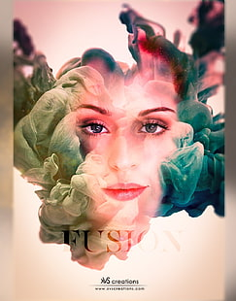
Introduction
What is Fusion?
Fusion: Certainly! In simple terms, fusion or synthesis is like mixing different things together to create something entirely new. It's the process of combining two or more separate things to make a completely different and unified thing. It's like making a new recipe by blending different ingredients or combining different colors to create a new shade. The result is a combination where the individual parts lose their original identity and form something entirely unique.

Slide 4
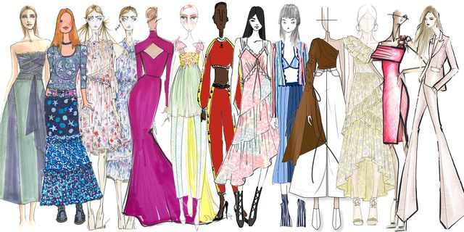
What is Fashion?
Fashion: Fashion refers to the popular styles, trends, and clothing choices that people adopt at a particular time. It's not just about what we wear but also encompasses the way we style ourselves, including accessories, hairstyles, and even the way we carry ourselves. Fashion is a way for individuals to express their personality, culture, and preferences through their clothing and overall appearance. It can vary widely across different cultures, time periods, and social contexts.

Slide 5
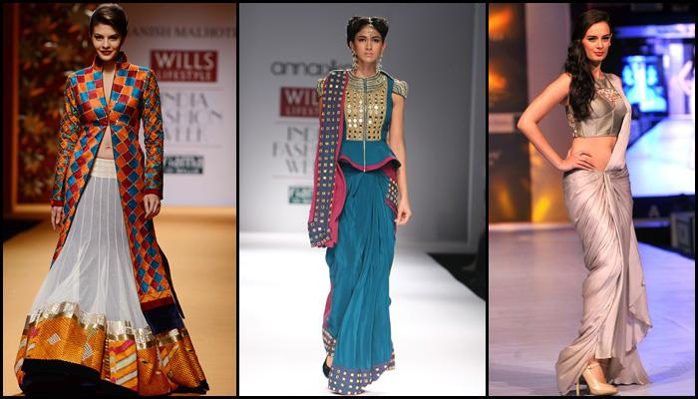
Fusion In Fashion
Fashion fusion is like creating a unique style masterpiece. It's about mixing creativity, showing your personal flair, and really understanding what looks good together. It's not just about copying what's popular or buying fancy designer clothes. Instead, it's an artful blend of different elements to make your own distinctive and stylish statement. It's all about expressing yourself through your clothes in a way that's truly one-of-a-kind.

Slide 6
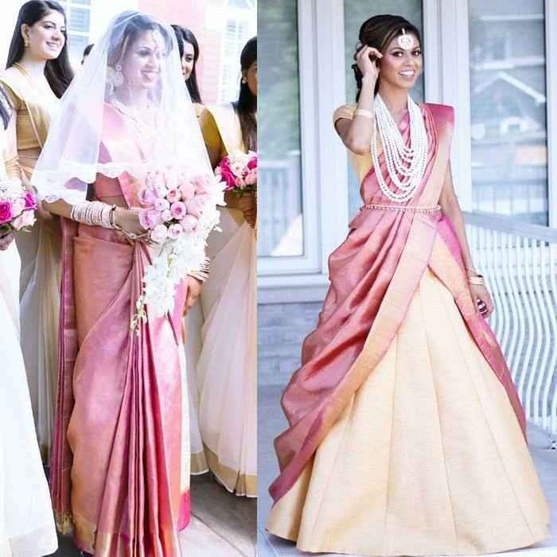
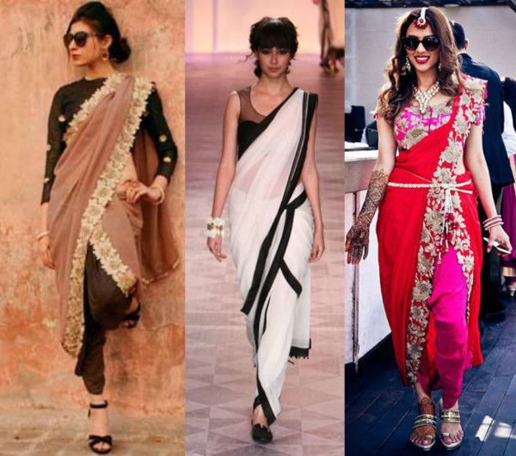
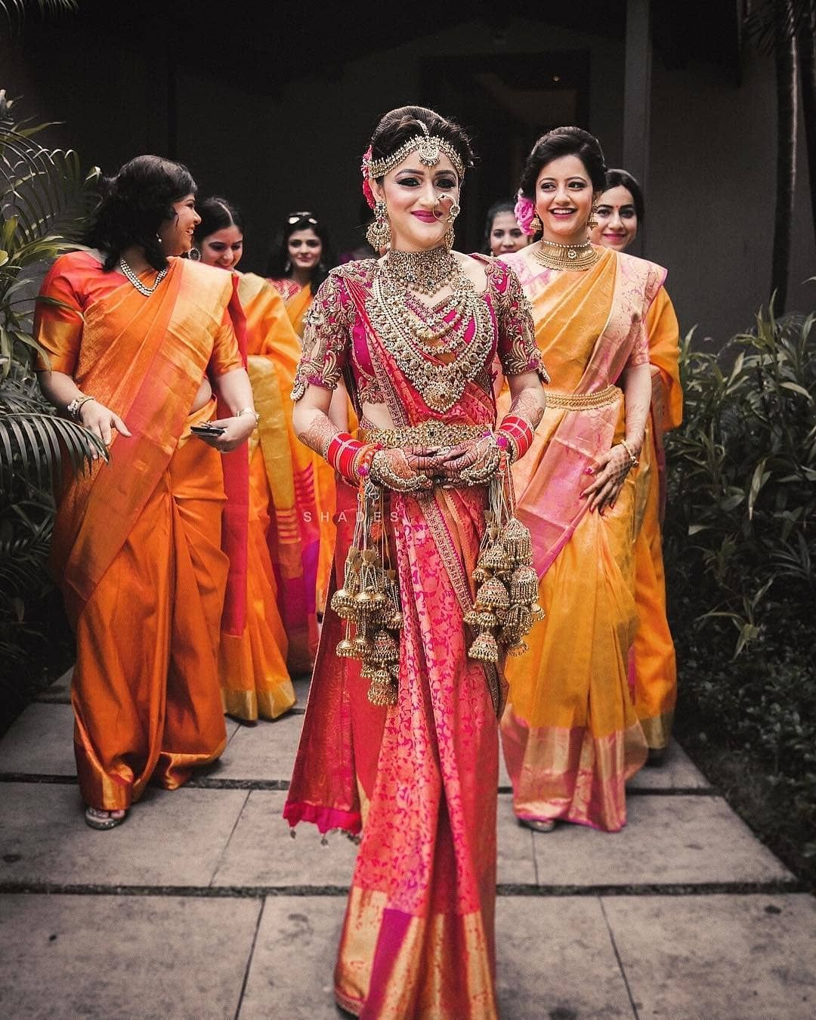
The key is to strike the right balance between traditional and modern elements.
Fusion
Festive Special
Wedding special
Fusion of traditional and western wear style
Fusion of South and West Indian style
Fusion of North and South Indian style

Slide 7
Fusion In India
Indian fashion trends often blend traditional ethnic styles with Western influences, resulting in a diverse range of clothing designs. These fusions can range from basic to highly imaginative. For instance, a person might wear a spaghetti top paired with a Bandhani print Rajasthani skirt and a scarf, showcasing a simple yet stylish fusion wear ensemble.
The spaghetti top reflects Western influences, while the skirt embodies Indian tradition in this fashion statement. This style of dressing seamlessly combines the best elements of both worlds.
Don't assume that this style is exclusive to women. For men, pairing a traditional Indian kurta with sports shoes and a scarf can create a fantastic look. These fusion styles are gaining popularity even among men.

Slide 8
Base to proceed with fusion
Basis of fusion styling
Fusion in clothing
Fusion in Colours
Fusion of cloths and accessories
Fusion on the basis of place
Fusion on the basis of occasions
There are many more, these are few basic concepts. It could be seasonal styling, such as short skirt, woollen stockings with a high neck top and traditional earrings.

Slide 9
Fusion Indian style have
Contemporary and Traditional Fusion
you wear Indian fusion clothes, it's like putting on traditions and cultural stuff that's been around for hundreds of years, but with a modern touch.
In India, fashion and clothes have a rich history, and people enjoy following these traditions. During festivals and weddings, folks like to dress in traditional outfits that remind them of the elegance and grandeur of the past. The fashion scene in India has seen a shift with the introduction of fusion wear. Modern women want to blend their contemporary style with vintage charm, and that's why Indo-western clothing is becoming popular. Fusion wear is adapting to new trends, playing around with traditional ethnic styles. Whether it's Kurtis paired with plain jeans or sarees matched with crop tops, and even lehengas with shirts, these are all examples of fusion wear.

Slide 10
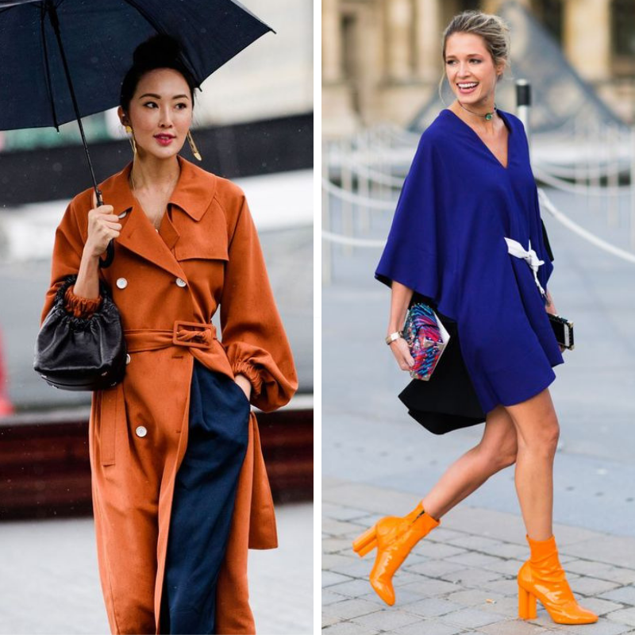
Fusion between colours
During the heart of winter, it's quite common to feel a bit bored with your clothes. The season seems to go on forever, with gloomy skies and chilly days, and you've been stuck in your warm clothes for months. However, spring is still a few weeks away. So, how do you add some excitement to your everyday outfits?
If you're up for experimenting with color combinations you haven't considered before, take a look at these 10 pairings. They always look good and will keep you stylishly cool (and hot!) even when the weather is dreary.

Slide 11
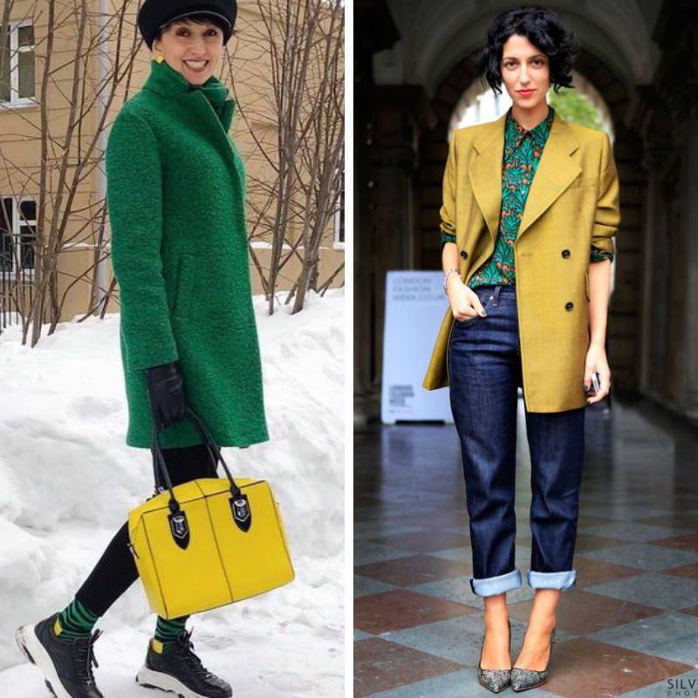
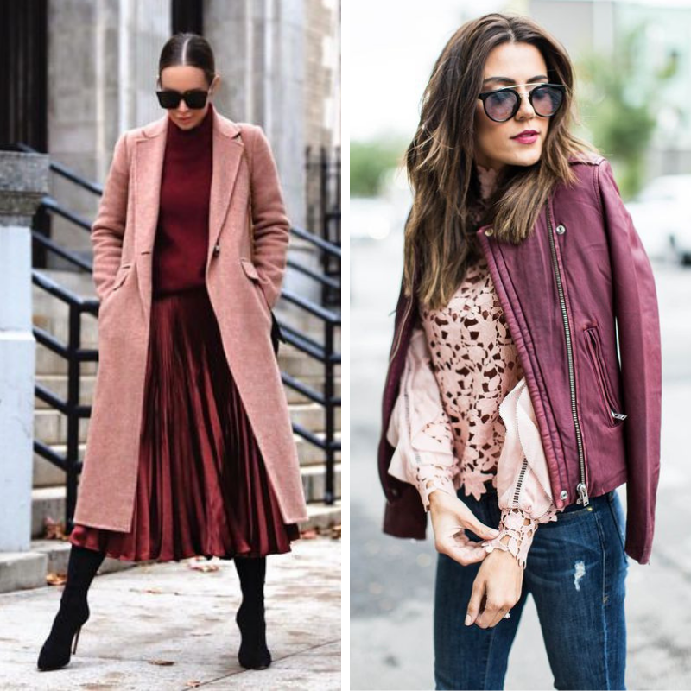
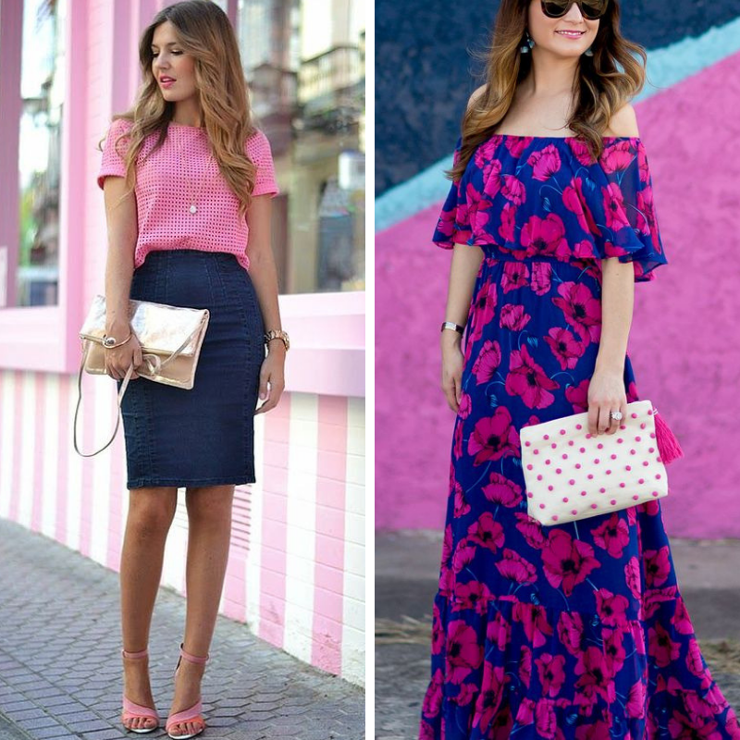
Fusion between Colours
Blush + Burgundy
Green + Yellow
Blue + Pink
Combination of Colours between clothing
Combination of colours between clothing, shoe, and Purse
Combination of colours between styling

Slide 12
Fusing Technology in Clothing Material
Interlining types
Types of Fusing in Garments
Reverse fusing
Sandwich fusing
Double fusing
Defects during Fusing Process
Fusing Machines
The Fusing Process
The Requirements of Fusing
Interlining is like a material placed between two layers of fabric to add more structure. A fusible interlining is a thin layer made from woven, knitted, or nonwoven material that's bonded either mechanically or thermally. When it's fused with a fabric panel, it provides extra strength, durability, and stability. It also makes sewing work easier.

Slide 13
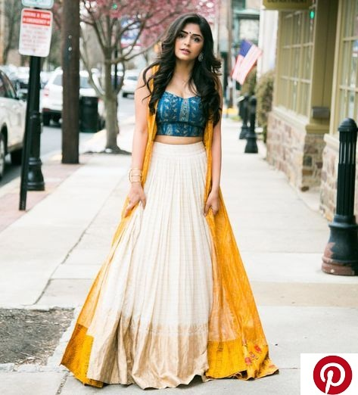
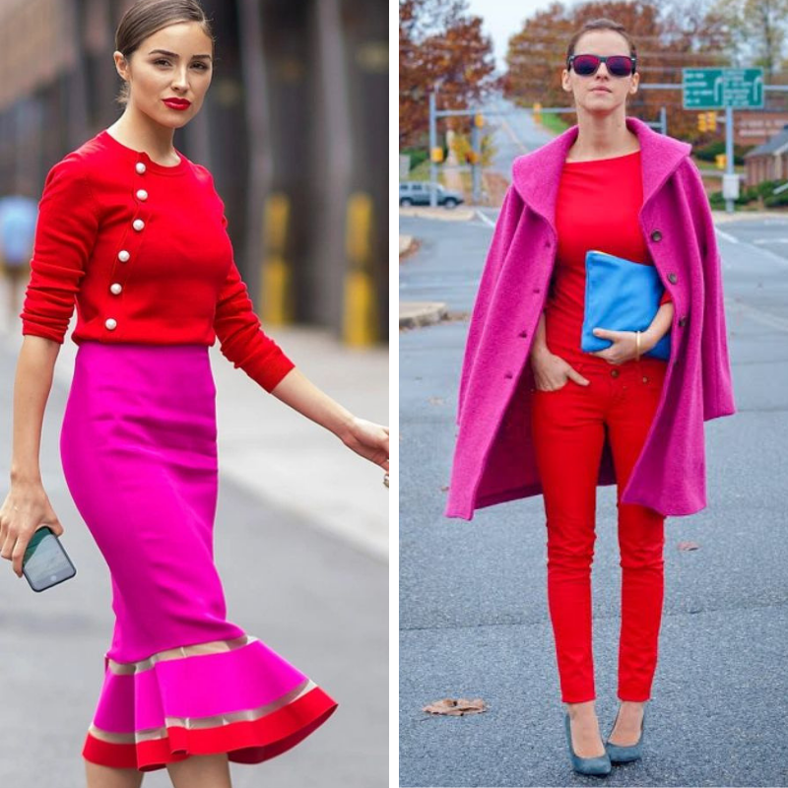
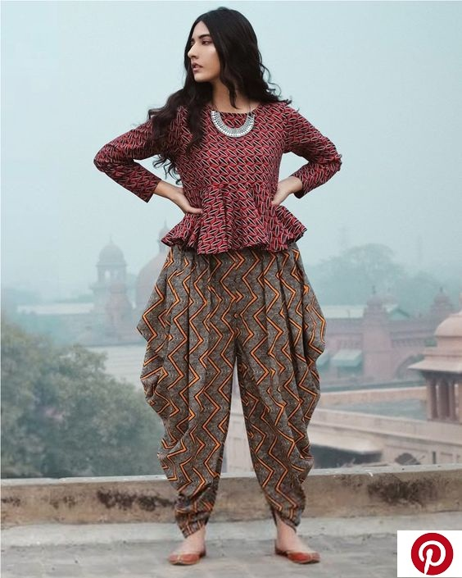

Slide 14
Thanks!
Amisha Anand

